Slide 1
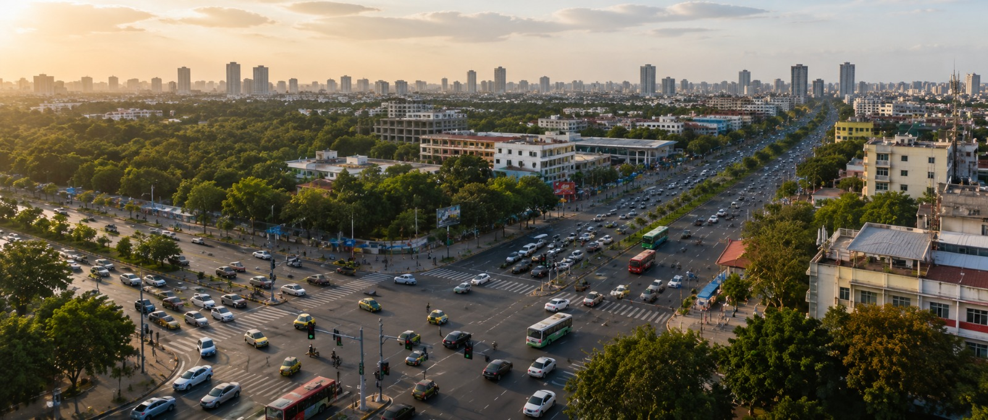
Project Olympus: Adaptive Urban Traffic Intelligence using Reinforcement Learning and Digital Twin-Based Discrete Event Simulation
Guided by,
Dr. T. Vincent Gnanaraj
Associate Professor
Department of Quantum Intelligence
SIMATS Engineering
192425312 CHEERALA JYOTHI
192425132 G AKSHYA
192472320 PARLA AKHILA
192472291 P DIVYASHREE

Slide 2
Abstract
This study presents a novel approach for intelligent urban traffic management using Reinforcement Learning (RL), Digital Twin technology, and Discrete Event Simulation (DES). A synthetic traffic dataset was generated to represent realistic urban traffic conditions and support simulation-based experimentation. The proposed framework was designed, implemented, and evaluated under multiple traffic scenarios to optimize adaptive traffic signal control. Statistical analyses were performed to compare the performance of the proposed model with conventional fixed-time traffic signal systems using metrics such as waiting time queue length travel time and vehicle throughput. The experimental results demonstrated improved traffic flow reduced congestion and enhanced operational efficiency over existing approaches. Visualization techniques were employed to analyze simulation outcomes and illustrate performance improvements across different traffic conditions. The proposed methodology provides a scalable and flexible solution for smart city traffic management and intelligent transportation systems. The study contributes an effective simulation-based framework that can be extended using real-time IoT data and advanced multi-agent reinforcement learning techniques for future urban mobility applications.

Slide 3
Introduction
Project Olympus is a smart traffic management system that improves urban traffic flow using Artificial Intelligence and simulation.
Adaptive Traffic Intelligence: A system that monitors traffic conditions and automatically optimizes traffic signal operations.
Reinforcement Learning (RL): An AI technique that learns the best traffic control decisions through continuous interaction with traffic scenarios.
Digital Twin & Discrete Event Simulation: A virtual model of the traffic network used to simulate vehicle movement and test traffic management strategies safely and efficiently.
Need for the Project: Rapid urbanization and increasing vehicle density have made efficient traffic management essential for reducing congestion and improving road safety.

Slide 4
Literature survey
Author(s), Year, Journal/Proceedings | Title | Key Findings
Baohong Wu, 2024, IEEE 4th International Conference on Power, Electronics and Computer Applications (ICPECA 2024) | Research on a Traffic Signal Control Method Based on Deep Reinforcement Learning | The paper proposes a traffic signal control method using Deep Reinforcement Learning (DRL) to improve traffic management efficiency. The approach allows an intelligent agent to learn optimal signal control decisions by interacting with the traffic environment.
Hongyang Jiang, Zhe Li, Zhenyu Li, Lei Bai, Hongyang Mao, Wolfgang Ketter, Rui Zhao, 2024, IEEE Transactions on Intelligent Transportation Systems | A General Scenario-Agnostic Reinforcement Learning for Traffic Signal Control | Developed an RL framework that generalizes across different traffic scenarios, improving adaptability without retraining for every intersection.
Ta-Yin Hu, Zhuo-Yu Li, 2024, IET Intelligent Transport Systems | A Multi-Agent Deep Reinforcement Learning Approach for Traffic Signal Coordination | Introduced a Double DQN-based multi-agent traffic signal controller that significantly reduced vehicle waiting time and queue length compared with conventional methods.
Vijayalakshmi K. Kumarasamy, Abhilasha Jairam Saroj, Yu Liang, Dalei Wu, Michael P. Hunter, Angshuman Guin, Mina Sartipi, 2023, IEEE Smart World Congress (SWC) | Traffic Signal Optimization by Integrating Reinforcement Learning and Digital Twins | Combined Digital Twins with decentralized multi-agent Reinforcement Learning to improve traffic signal optimization and reduce network-wide congestion.

Slide 5
Literature survey
Author(s), Year, Journal/Proceedings | Title | Key Findings
Vijayalakshmi K. Kumarasamy, Abhilasha Jairam Saroj, Yu Liang, Dalei Wu, Michael P. Hunter, Angshuman Guin, Mina Sartipi, 2023, IEEE Smart World Congress (SWC) | Traffic Signal Optimization by Integrating Reinforcement Learning and Digital Twins | Combined Digital Twins with decentralized multi-agent Reinforcement Learning to improve traffic signal optimization and reduce network-wide congestion.
Junyun Ruan, Jinzhuo Tang, Ge Gao, Tianyu Shi, Alaa Khamis, 2023, IEEE International Conference on Smart Mobility (SM 2023) | Deep Reinforcement Learning-based Traffic Signal Control | The study applies Deep Q-Network (DQN) and Double DQN (DDQN) to optimize traffic signal control at urban intersections.
IEEE Sensors Journal, 2023 | Reinforcement Learning-Based Intelligent Traffic Signal Control Considering Sensing Information of Railway | Implemented DQN and PPO with SUMO simulation, demonstrating better traffic efficiency than fixed-time signal control in complex transportation environments
Lingling Fan, Yusong Yang, Honghai Ji, Shuanghuang Xiong, 2023, 2023 IEEE 12th Data Driven Control and Learning Systems Conference (DDCLS). | Research on Cooperative Control of Traffic Signals Based on Deep Reinforcement Learning | The paper proposes a cooperative traffic signal control method using Deep Reinforcement Learning (DRL). A traffic performance evaluation index is designed.

Slide 6
Research Gaps
Most existing studies focus only on Deep Reinforcement Learning and do not integrate Digital Twin technology for realistic traffic monitoring and optimization.
Several approaches are evaluated on single intersections, while city-wide adaptive traffic coordination remains insufficiently explored.
Existing traffic control methods often use limited or real-world datasets, with less emphasis on generating realistic synthetic traffic data for extensive simulation.
Current frameworks rarely combine Discrete Event Simulation (DES) with Reinforcement Learning to accurately model dynamic traffic events.
Most existing solutions have limited scalability for future smart city environments, where adaptive, simulation-based, and intelligent traffic management is required.

Slide 7
Problem Statement
Existing traffic signal control systems are unable to adapt efficiently to dynamic traffic conditions, leading to congestion and increased waiting time.
Current Deep Reinforcement Learning-based traffic control approaches optimize signal timing but lack integration with Digital Twin and Discrete Event Simulation for real-time traffic modelling and prediction.

Slide 8
Objectives
Develop an adaptive traffic management system using Reinforcement Learning, Digital Twin, and Discrete Event Simulation.
Optimize traffic signal timings to reduce congestion, waiting time, and travel time.
Evaluate and compare the proposed system with existing traffic control methods using performance metrics.
Generate a realistic synthetic traffic dataset for simulation and model training.
Visualize traffic performance and simulation results using statistical analysis and graphical representations.

Slide 9
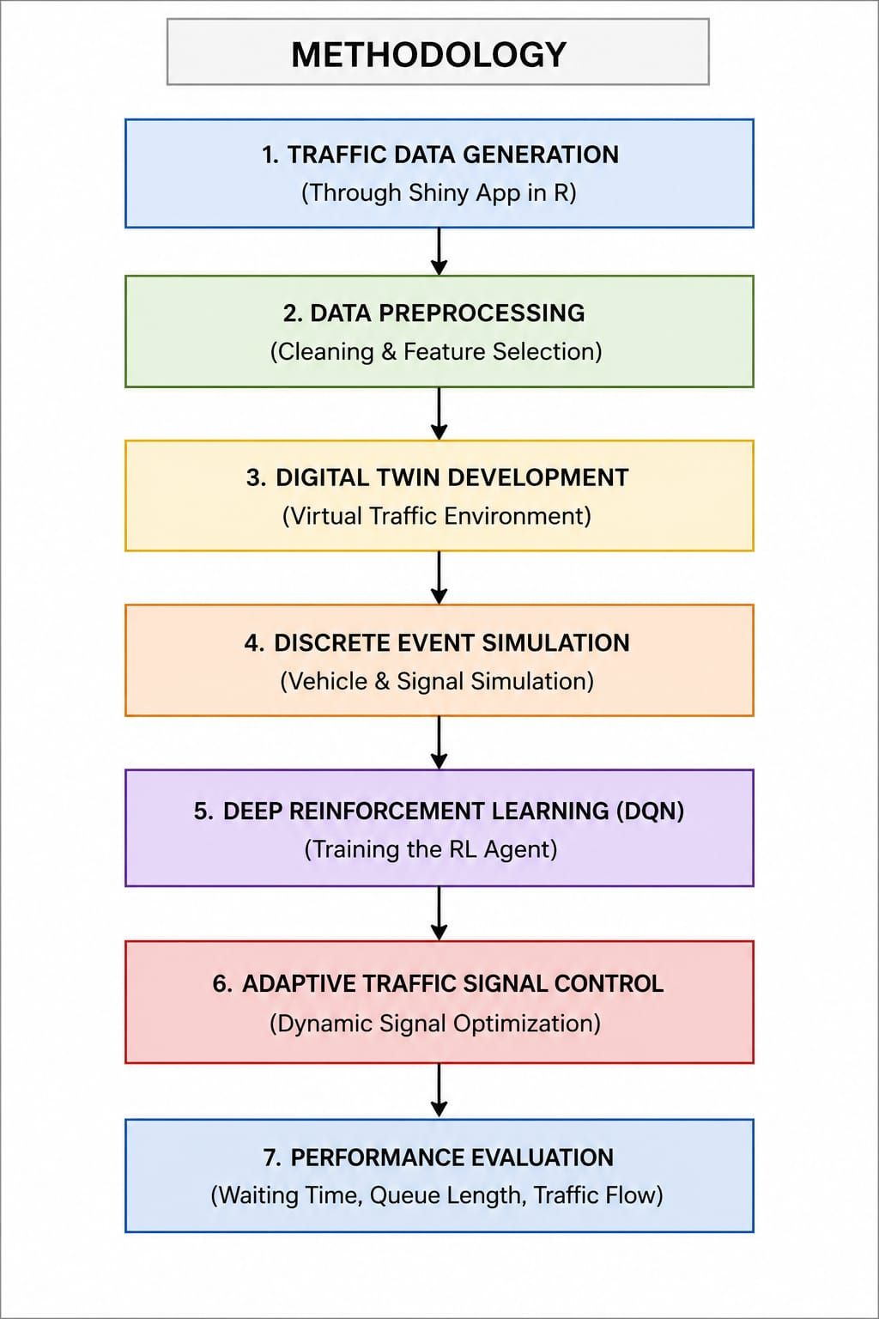
Methodology
Generate synthetic urban traffic data using a Shiny Application in R.
Clean, organize, and prepare the traffic dataset for analysis.
Create a virtual model of the urban traffic network.
Simulate vehicle movement, traffic signals, and congestion scenarios.
Train an intelligent agent to learn optimal traffic signal timings.
Dynamically adjust signal timings based on current traffic conditions.
Measure waiting time, queue length, travel time, and traffic flow efficiency.
Compare the proposed system with conventional traffic signal control and analyze the improvements.

Slide 10



Formulas
Q=N/T
$$\text{AWT}\text{=}\text{N}\text{∑}\text{Wi}\text{​​}$$
$$\text{Rt}\text{​=−(}\text{α}\text{Wt}\text{​+}\text{β}\text{Qt}\text{​)}$$
$$\text{Q}\text{(}\text{s}\text{,}\text{a}\text{)=}\text{r}\text{+}\text{γa}\text{′}\text{max}\text{​}\text{Q}\text{(}\text{s}\text{′,}\text{a}\text{′)}$$

